Slide 1
Back to school night
Contact Information:
Ms. Rachel Nulty
rnulty@cbsd.org
Room – C307
AP European History
10th Grade – 27 Weeks / 1.5 Credit

Slide 2
Canvas Pairing and Syllabus
1. Please note – if you are in the classroom – the syllabus and the canvas pairing directions are available. If you are at home – please click on the links below for each document.
2. Canvas Pairing Directions link
3. Syllabus Link:

Slide 3
What do we study?
Advanced Placement European History provides students with a broad knowledge of European history since 1400 CE and a variety of writing and document interpretation skills.
The course is designed for honors level students who seek advanced placement credit. Units focus on topics addressing the major themes and historical thinking skills outlined by the College Board.
A variety of techniques and learning strategies will be utilized to help students understand these themes and their impact. Due to the intensiveness of the course, it is expected that students will be motivated, attentive and diligent both in and out of the classroom setting.
Additionally, students are expected to sit for the Advanced Placement Examination in European History, to be administered May 6, 2022 by the College Board.

Slide 4
Units
Unit One: Middle Ages, Renaissance 1300-1450
Unit Two: Age of Reformation 1450 - 1648
Unit Three: Absolutism and Constitutionalism 1648-1815
Unit Four: Scientific Revolution and Enlightenment 1648-1815
Unit Five: Conflict, Crisis and Reaction in the Late 18th Century 1648-1815
Midterm Exam (December)
Unit 6: Industrialization and Its Effects 1815-1914
Unit 7: 19th Century Perspectives and Political Developments 1815-1914
Unit 8: 20th Century Global Conflicts 1914-Present
Unit 9: Cold War and Contemporary Europe: 1914-Present
Final Exam: April 2022
National Exam (May 6, 2022)

Slide 5
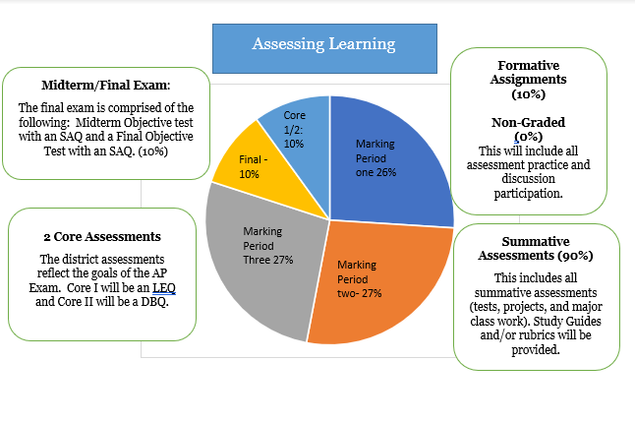
Grading and Assessments
Midterm
Final Exam
Core Assessment One – LEQ
Core Assessment Two- DBQ

Slide 6
Infinite Campus
All major projects and tests will be listed in the summative category and will be worth 90% of the marking period grade.
Major classwork and other pertinent assignments will be listed in the formative category and will be worth 10% of the marking period grade.
Please note that I have also included non-graded categories that do not count against the actual grade. There is the practice homework and classwork category and the practice quizzes and progress checks category. I hope that this gives you important feedback about class/homework completion and practice quizzes etc.
It is expected that students hand in work on time and that they check their grades on IC daily.

Slide 7
Core Assessments
Both will make up 10% of entire grade.
They mimic the AP National Exam Essays
Long Essay Question (will be completed in Fall)
Document Based Question (will be completed in the Spring)

Slide 8
Final Exam = Midterm and Final
Students will take a final exam in two parts: Midterm in December and Final in April. (The Final in April covers material from December to April only)
Students will have a study guide and study sessions to help them prepare.
The Midterm and Final are MC questions and Short Answer questions
There is a district curve.

Slide 9
Textbook
A History of Western Society – McKay
Western Civilization: Sources, Images and Interpretations (PDF reading available on Canvas)
Supplementary materials provided over the course of the semester

Slide 10
Daily Agenda - Canvas
The agenda for the day and week are available under Daily Activities in each unit.

Slide 11
Calendar on Canvas
All assignments for all classes are listed in Canvas calendar on the day it is due and the time due is also listed.

Slide 12
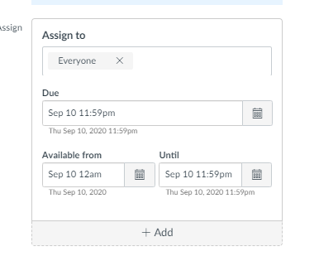
Assignment Submission
Canvas assignments have opening dates and end dates. If your child could not submit – it most likely means that they are handing it in late.
Either way, they should email at the time and include the assignment if there is some other technical issue. Work should be handed in on time.

Slide 13
Copy of powerpoint
In every unit, a copy of the PowerPoint is listed for student use.

Slide 14
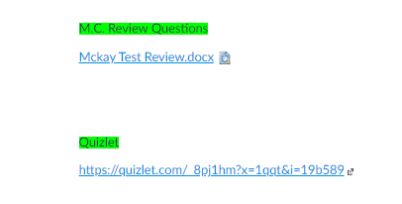
Study guide and test
A study guide is available usually from the very beginning of the unit. The tests will be given during class in collegeboard site – MYAP.

Slide 15
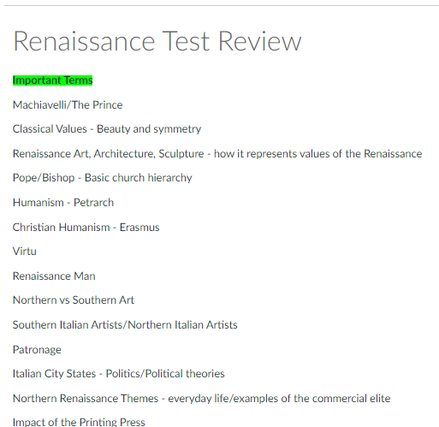
Study guides
The quizlets will sometimes be used in class but they can also be used by students as flashcards for studying

Slide 16
AP Classroom – Collegeboard
Quizzes and tests will be administered through this site.

Slide 17
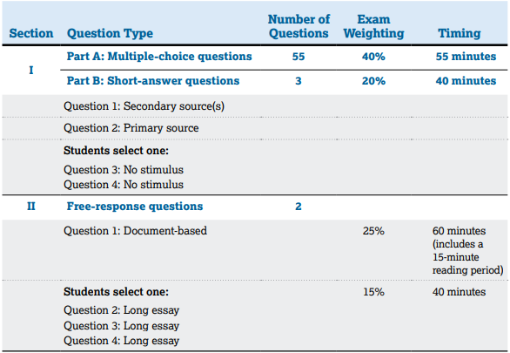
National Exam
Sign up through collegeboard account.
This signup is happening soon.
Contact Mr. Hill (thill@cbsd.org) for more information

Slide 18
Student will succeed if they..
make full use of Canvas – class materials, lecture notes, readings, agendas, and other resources will be regularly available.
complete all assignments before, and during, class.
study.
ask questions and actively participate.
are responsible. If you have been absent and missed work, find out what it was and make it up as soon as possible.
ask for help. Office hours are available every week.
collaborate. This is a 27-week course, get to know each other. You never know who might be able to help you out or who you may be able to help.

